Slide 1

END OF COURSE AGENDA
REVIEWS
FUTURE COURSES
LINKEDIN CERT & API
CLAIM APPLICATION

Slide 2
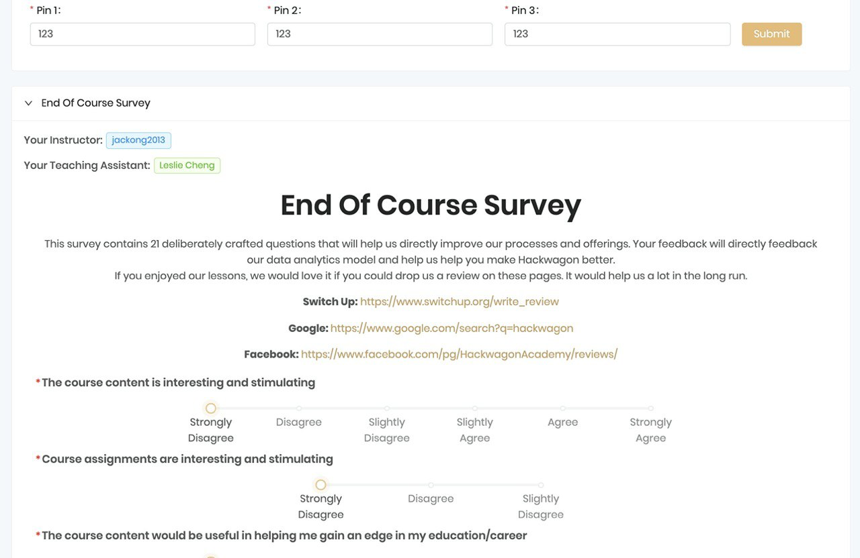

Slide 3

COURSE ONLINE REVIEW
We had a great time together and we hope you can help us by reviewing us on several platforms
SWITCH UP REVIEW
https://www.switchup.org/write_review

Slide 4
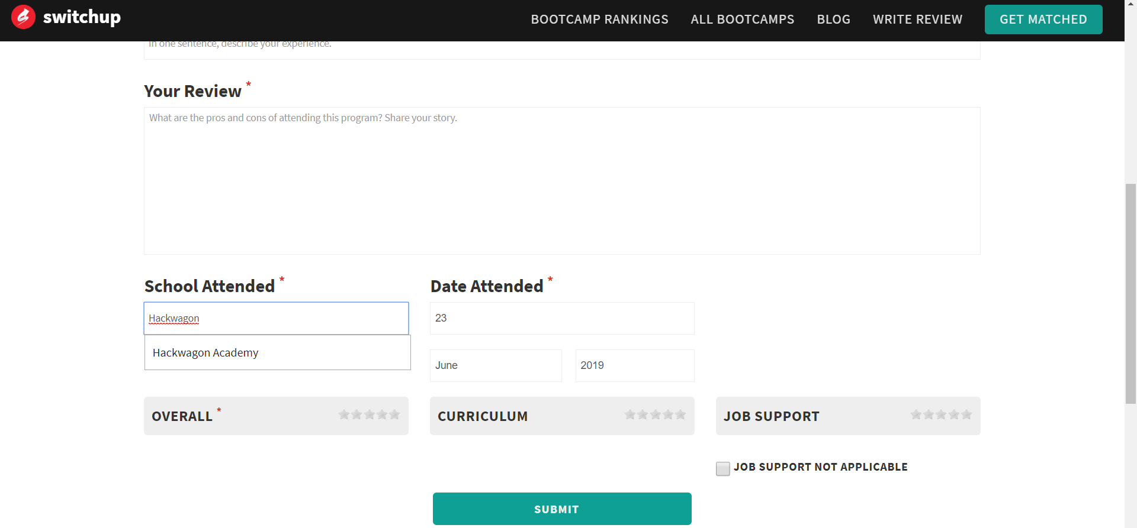
COURSE ONLINE REVIEW
SWITCH UP REVIEW
Type “Hackwagon” and dropdown will be available for selection
For date, fill in the first lesson date

Slide 5
COURSE ONLINE REVIEW
We had a great time together and we hope you can help us by reviewing us on several platforms
FACEBOOK REVIEW
https://www.facebook.com/pg/HackwagonAcademy/reviews/

Slide 6
COURSE ONLINE REVIEW
We had a great time together and we hope you can help us by reviewing us on several platforms
GOOGLE REVIEW
Google Reviews found at the bottom left corner (Accessible via desktop) -
https://www.google.com.sg/maps/place/Hackwagon+Academy/@1.2730737,103.8016533,17z/data=!3m1!4b1!4m5!3m4!1s0x31da19e62561dd09:0x877559a27abc75f6!8m2!3d1.2730737!4d103.803842

Slide 7
IMPORTANT LINKS
Important Items | Links
Alumni Network Group | Telegram Link
Hackwagon Elearn | https://learn.hackwagon.com
Add certificate to linkedin | Linkedin Add Cert to Profile
ICMS Grant Submission Portal | https://eservice.imda.gov.sg/icms/
Direct Credit Authorisation Form | Link to DCA Form

Slide 8

DATA SCIENCE TRACK
DS102: ADVANCE
PYTHON METHODS
ADVANCED DATA VISUALISATION
WEB SCRAPING
MACHINE LEARNING

Slide 9

FULL STACK TRACK
FS101: INTRODUCTION TO WEB DEVELOPMENT
BUILDING YOUR OWN PORTFOLIO WEBSITE
HTML,CSS & JAVASCRIPT OVER 7 WEEKS
JQUERY & REST APIs

Slide 10
CYBER SECURITY TRACK
CS101: INTRODUCTION TO CYBER SECURITY
ZERO KNOWLEDGE REQUIRED
FOUNDATION OF CYBER SECURITY
TAKING ON THE ATTACKER’S MINDSET

Slide 11
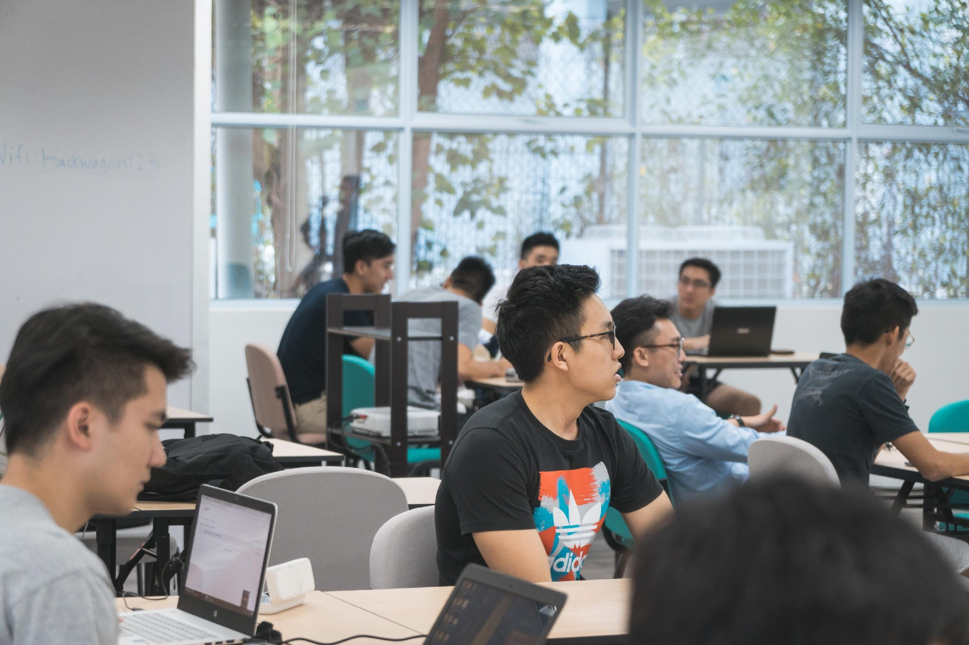
ALUMNI
NETWORK
Telegram Link

Slide 12
LINKEDIN DIGITAL CERT
Congrats on reaching this far! We have a digital cert that you can showcase on Linkedin endorsed by Hackwagon
DIGITAL CERT
Update your Linkedin with your new proficiency
Link 1: https://learn.hackwagon.com
Link 2: https://www.linkedin.com/profile/add?startTask=hackwagon

Slide 13
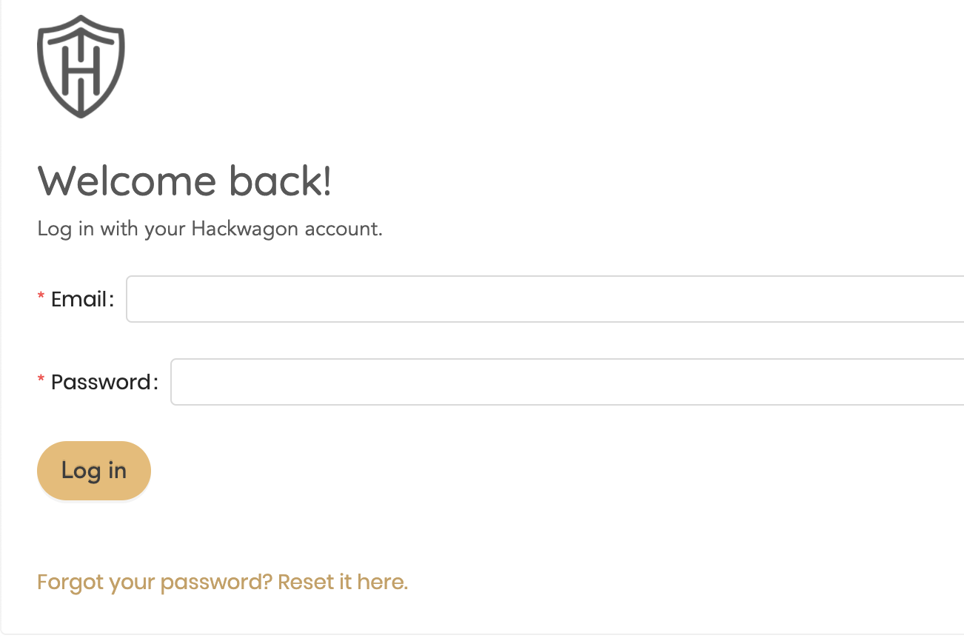
LINKEDIN DIGITAL CERT
Sign in with your Hackwagon account details

Slide 14
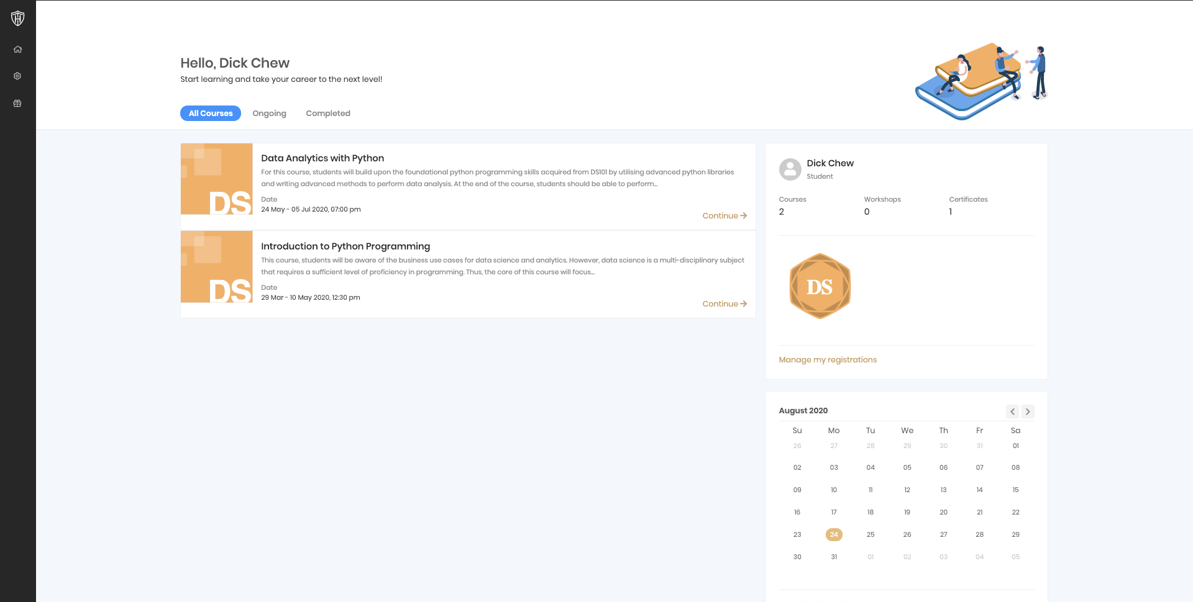
LINKEDIN DIGITAL CERT
Click on badge to view certificate

Slide 15

LINKEDIN DIGITAL CERT
copy the url as CERT URL , cert ID as LICENSE NUMBER

Slide 16
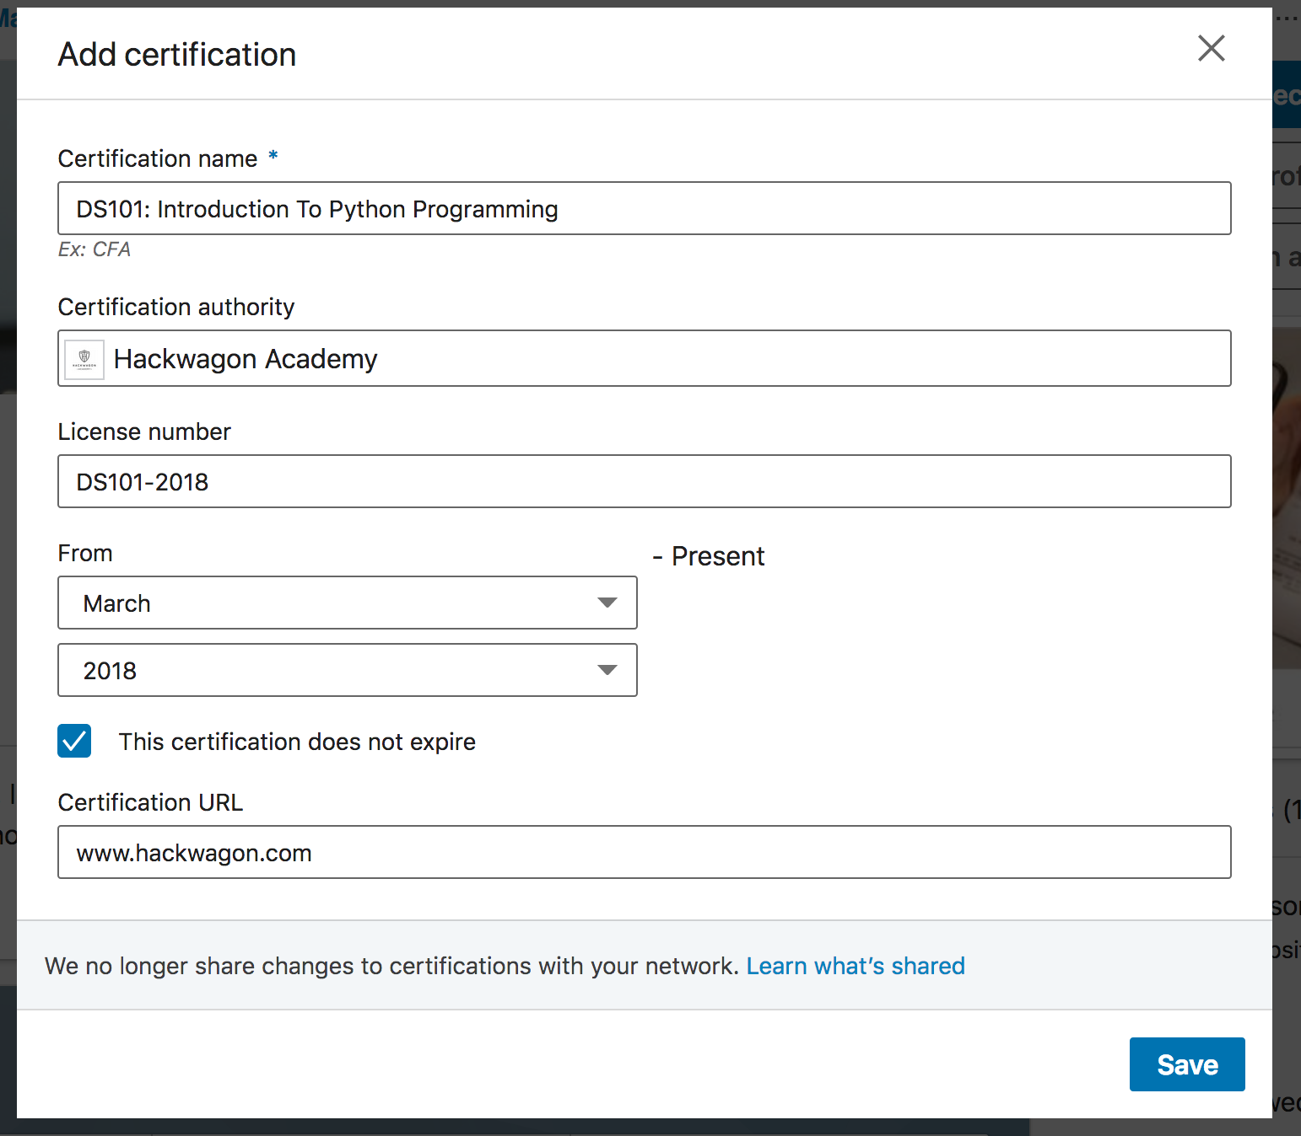
LINKEDIN DIGITAL CERT
Fill in the details on this page as per stated in the image above, as well as to fill in your own certification URL and certificate ID (license number)

Slide 17
CLAIM APPLICATION
Things to prepare
1. Invoice (Emailed to you at the start of the course, check your spam mail if you didn’t receive it)
2. Receipt (Emailed to you after payment, check your spam mail if you didn’t receive it)
3. Hackwagon Certificate
4. Direct Credit Authorisation Form (For the government to GIRO the subsidy amount to your bank account)
5. Attendance document (Attaining 75% attendance)
6. If claimed Skillsfuture, prepare screenshot of Skillsfuture Credit Transaction History (Steps given later)
*Notes: Search for “Xero” when looking for receipt/invoice in your email

Slide 18
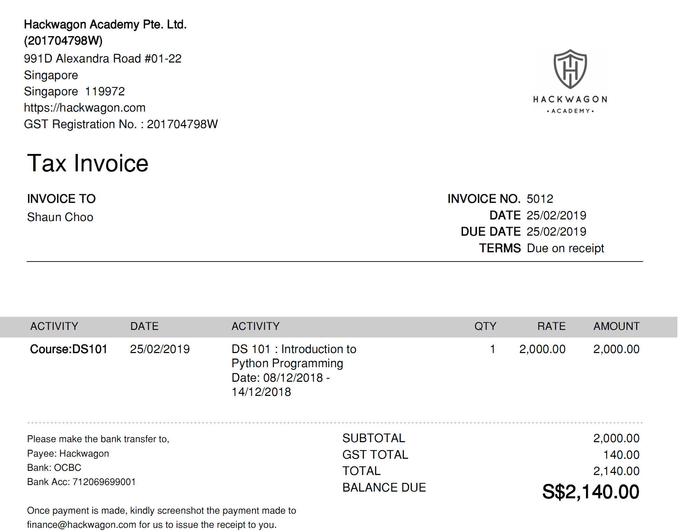
Invoice
Template

Slide 19
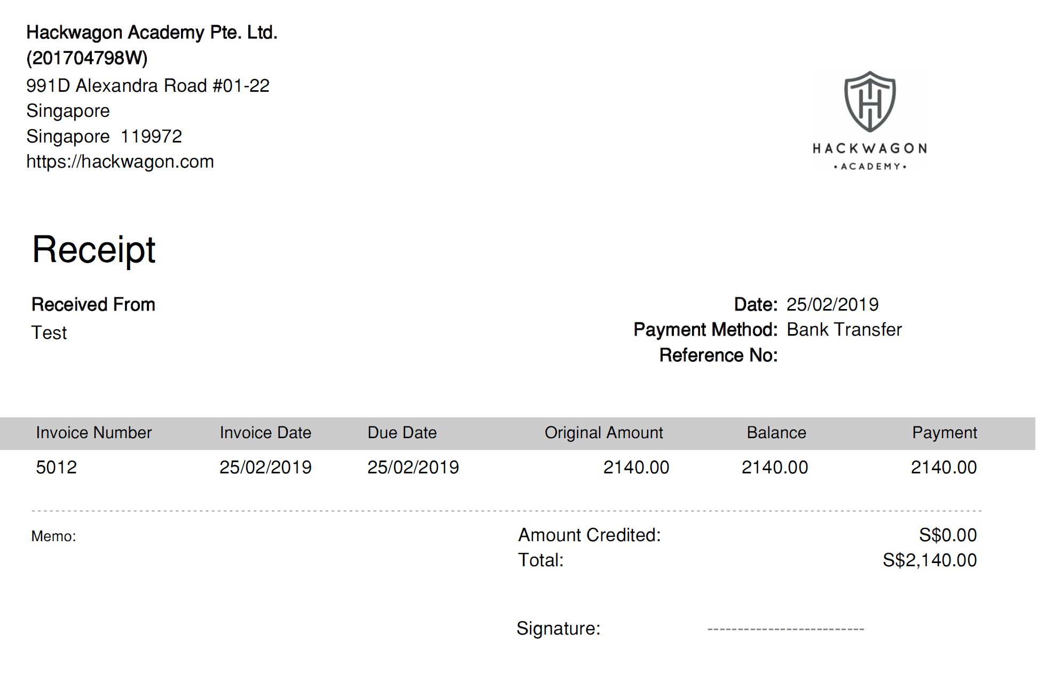
Receipt
Template

Slide 20
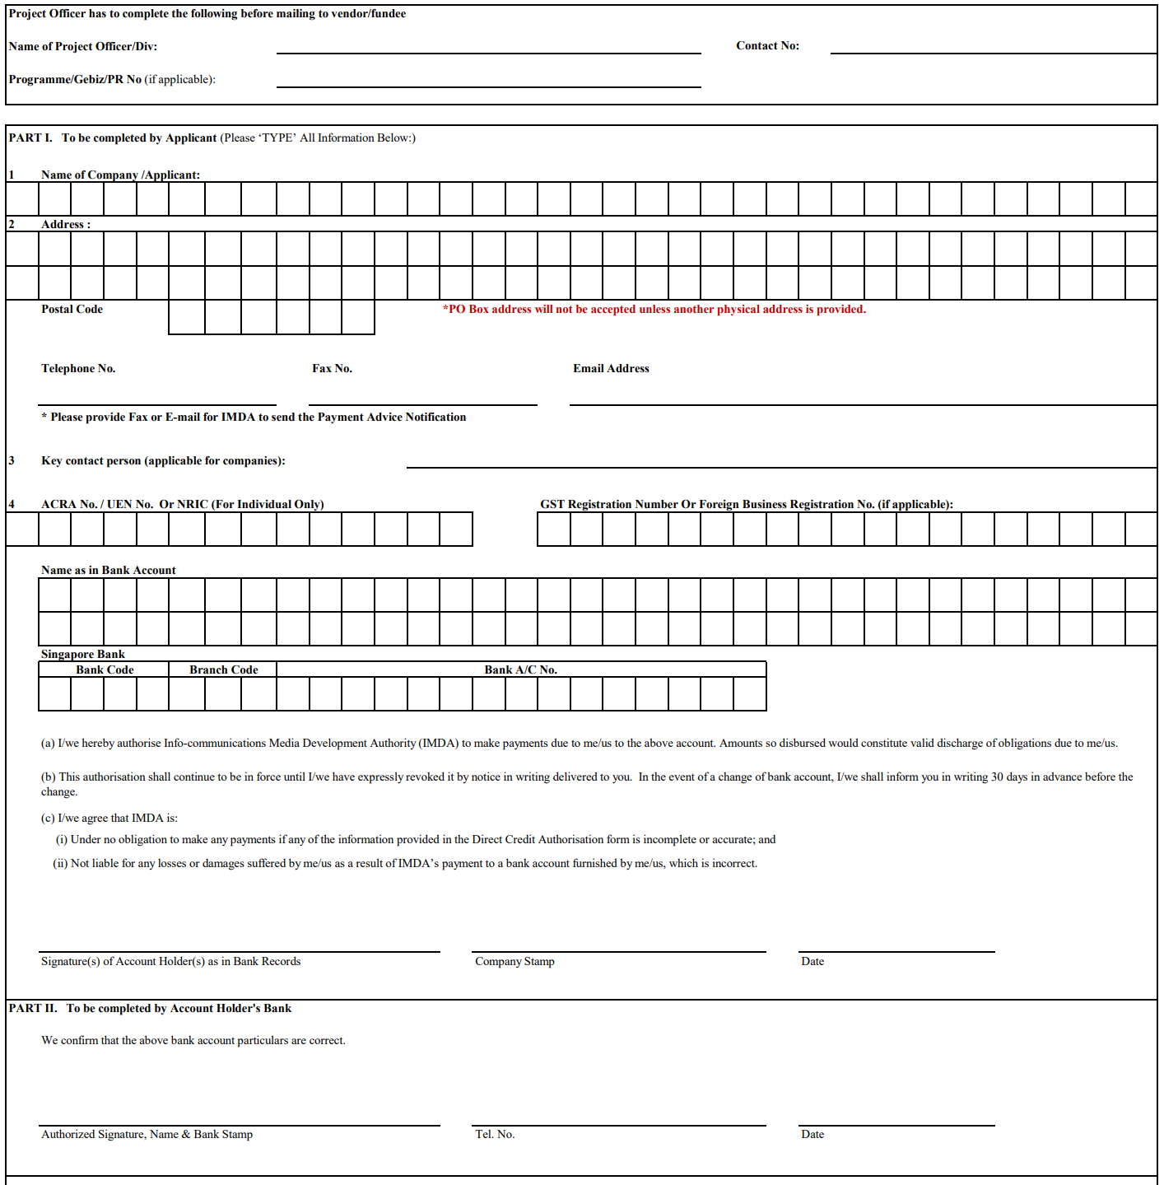
DCA FORM
(NON-OCBC ACC)
Project Officer Section
Leave Blank
Part 1
Fill Up accordingly
*If you have no company stamp, leave blank
Part 2
Bring to your Bank to endorse
Once completed,
scan and upload softcopy to portal as shown later

Slide 21
DCA FORM
(OCBC BANK
HOLDERS)
Project Officer Section
Leave Blank
Part 1
Fill Up accordingly
*If you have no company stamp, leave blank
Part 2
Don’t need to bring to the bank to endorse because OCBC doesn’t do endorsements
*Required instead to upload scanned copy of both OCBC bank statement & DCA form

Slide 22
CLAIM APPLICATION
How to Complete your Claim
Grant needs to be applied through the government ICMS portal (https://eservice.imda.gov.sg/icms/)
Deadline for submission of claim is 3 months from the official end of course
You should already have the account, it is the same as the one you use to acknowledge enrolment
Prepare Direct Credit Authorization Form (For the government to GIRO the subsidy amount to your bank account) Link to DCA Form
Invoice
Receipt
Hackwagon Certificate – this will be ready by Next Friday
Attendance document (Attaining 75% attendance) – this will be sent to class telegram group by Next Friday

Slide 23
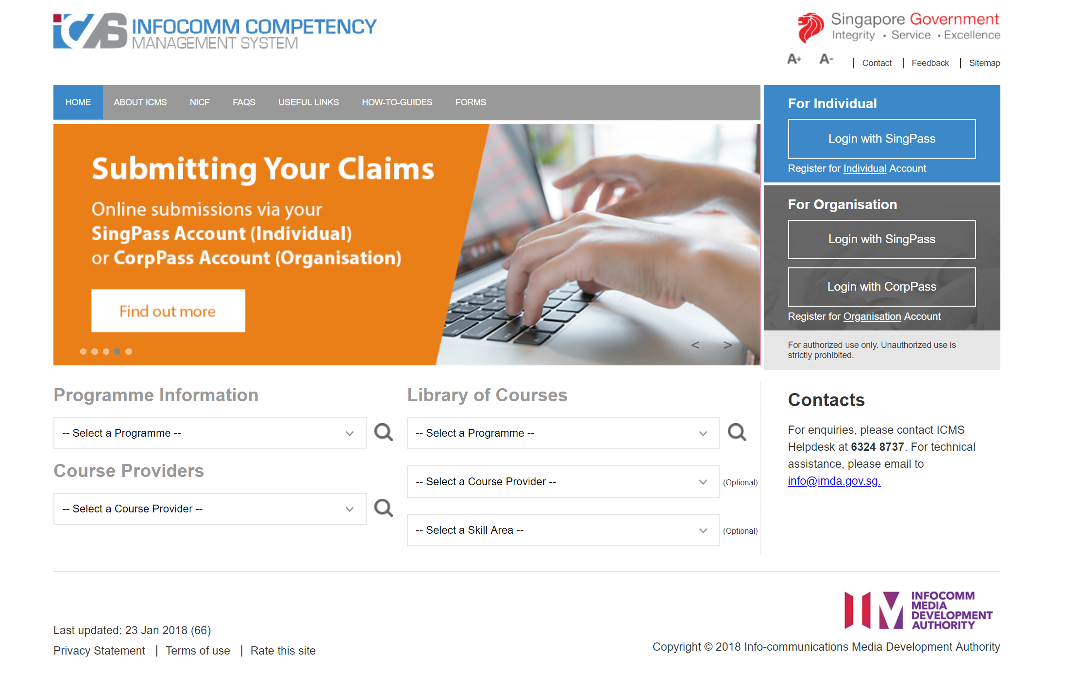
CLAIM APPLICATION
REGISTER FOR AN ACCOUNT
Click here to create an account if you’re Individual Sponsored
Click here to create an account if you’re Company
Sponsored
STEP 1 SCREEN: ICMS Website

Slide 24
CLAIM APPLICATION
After ICMS Account Has Been Approved
STEPS:
Register for an account in ICMS, https://eservice.imda.gov.sg/icms/ (On the right) - If you haven’t register
Login into ICMS after account is approved after 3 working days (Email will be sent notifying you) - If you haven’t register
Click on “Login Now” under Existing users and proceed to sign in with your Singpass ID and password.
Click on “Claim Application” found on the left menu bar
Click on “New Application” at the bottom
Programme name: CITREP + SF ( 1 APRIL 2019 - 31 March 2021)
Select Course Provider - "Hackwagon Academy Pte Ltd"
Select Course/Certification Title - "DS101 - Introduction to Python Programming"
Review the enrolment detail (Course fees $2000 & Exam Fees $0)
Click on submit for approval.
Complete T&C section
Complete Survey
IMDA will send out an auto-generated email to remind you to upload your documents. If you have already uploaded all the documents, you can disregard the email.

Slide 25
CLAIM APPLICATION
LOG INTO THE PORTAL TO START SUBMISSION
Click here to sign in if you’re Individual Sponsored
Company will click here to sign in if you’re Company
Sponsored
STEP 2: Sign In

Slide 26
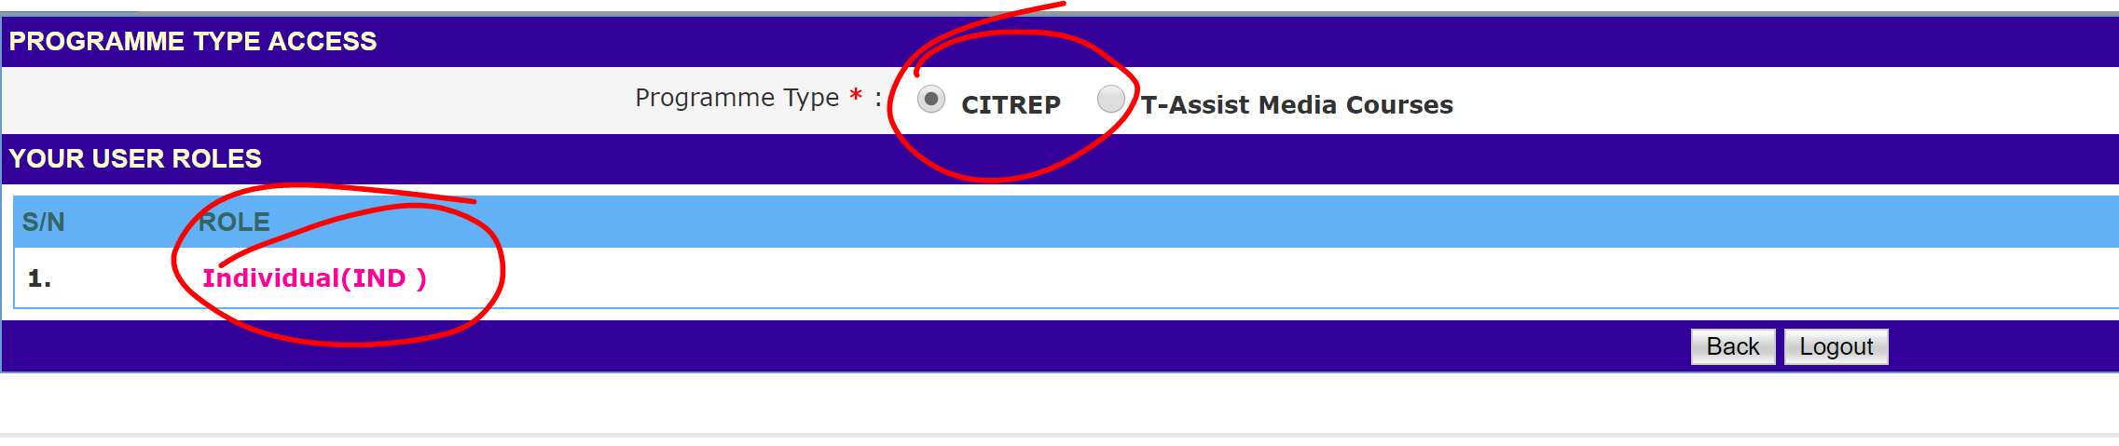
CLAIM APPLICATION
Entering ICMS
STEP 3: Sign In

Slide 27
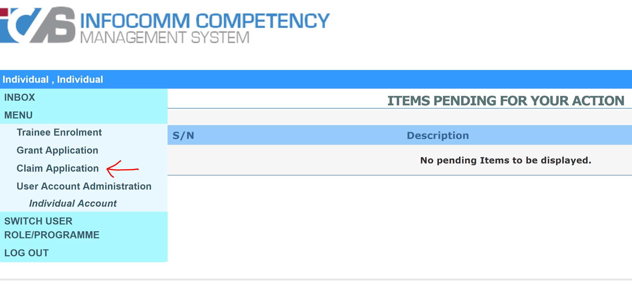
CLAIM APPLICATION
Click on
Claim Application
STEP 4: Click on Claim Application

Slide 28
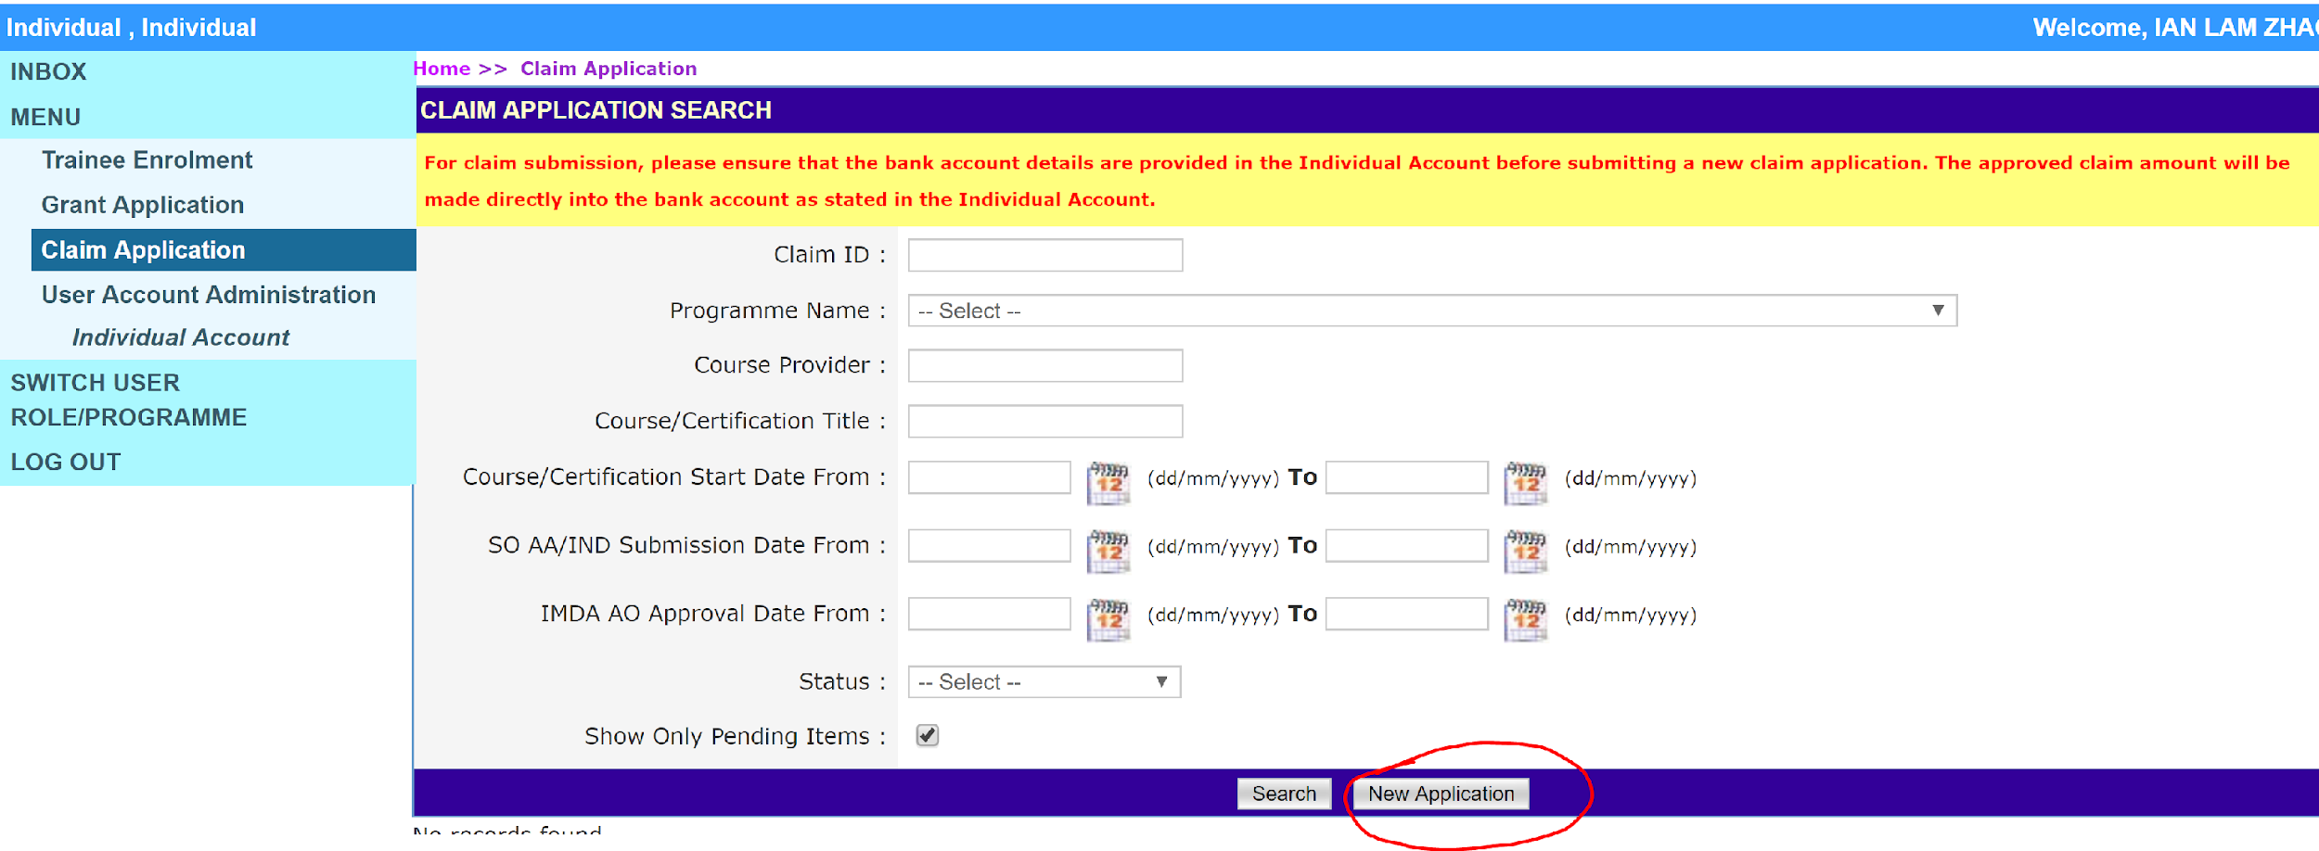
CLAIM APPLICATION
Click here to create your application
STEP 5: Click on New Application

Slide 29
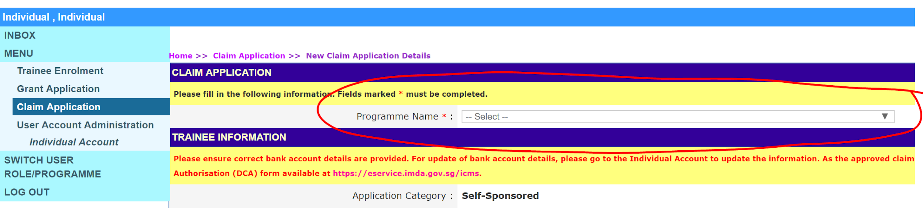
CLAIM APPLICATION
CITREP + SF ( 1 APRIL 2019 - 31 March 2021)
STEP 6: Select Programme Name

Slide 30
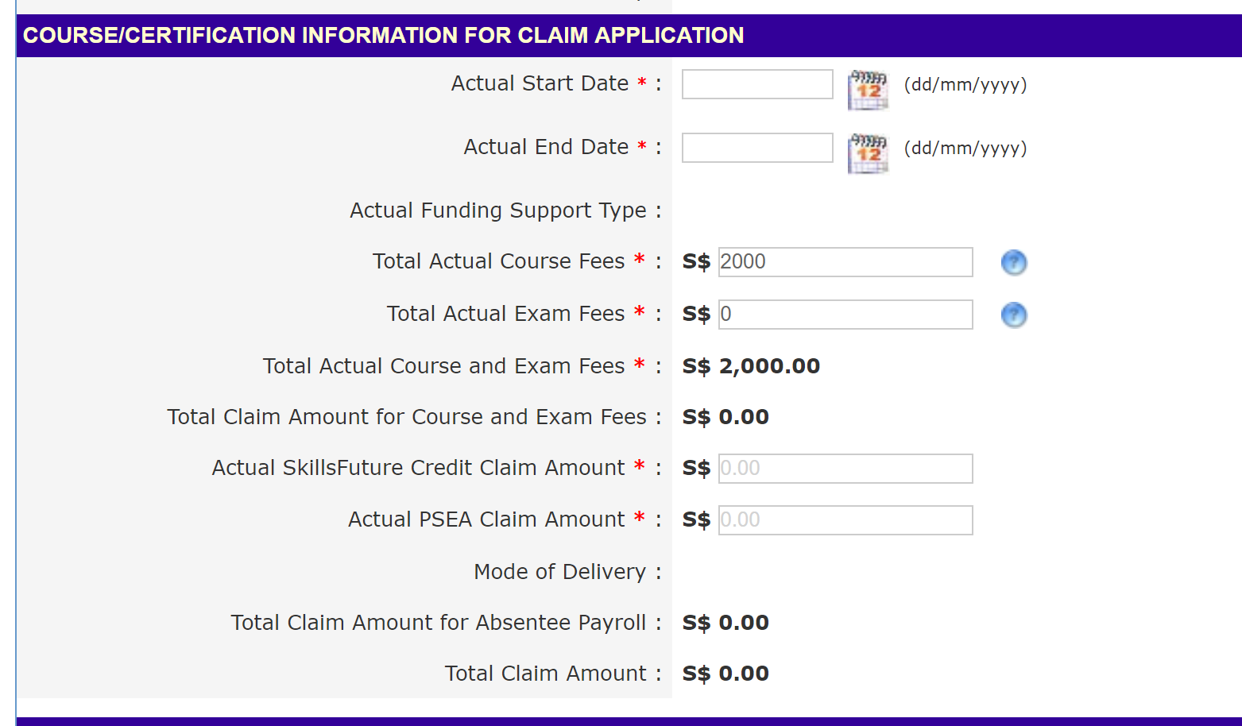
CLAIM APPLICATION
Trainees using SkillsFuture Claim
For the Skillsfuture amount, IMDA needs to see the Skillsfuture amount covering the course fee. Hence ensure you input the total Skillsfuture amount that you have used.
STEP 7: Enrolment Information

Slide 31
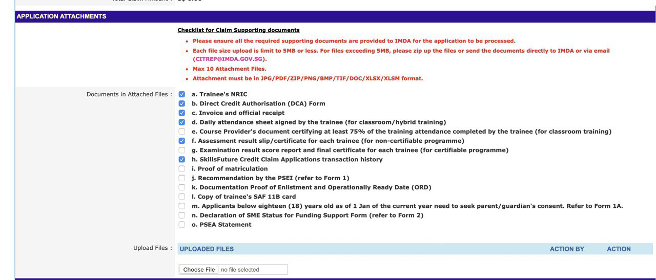
CLAIM APPLICATION
ATTACHMENTS NEEDED
References
Item a
Not needed anymore
Item h
If you claimed Skillsfuture on top of your IMDA Citrep+ subsidy please follow the steps in the next page
STEP 8 SCREEN: COMPLETE APPLICATION FORM

Slide 32
SKILLSFUTURE CLAIM APPLICATION HISTORY STEPS
a. Access the Skillsfuture Credit portal http://www.skillsfuture.sg/Credit#section1
b. Login via SINGPASS
c. Select Credit Transaction History
d. Take a screenshot following the criteria below ensuring that the following are reflected in one single page:
a) MySKILLSfuturefuture logo/background
b) Your Name
c) Claims Application tab history (i.e. your claims to date)
e. Receipt given by Hackwagon on your skillsfuture claims
Note: You may need to adjust your resolution or magnification of your browser to be able to obtain it in one picture. (see attached samples)

Slide 33
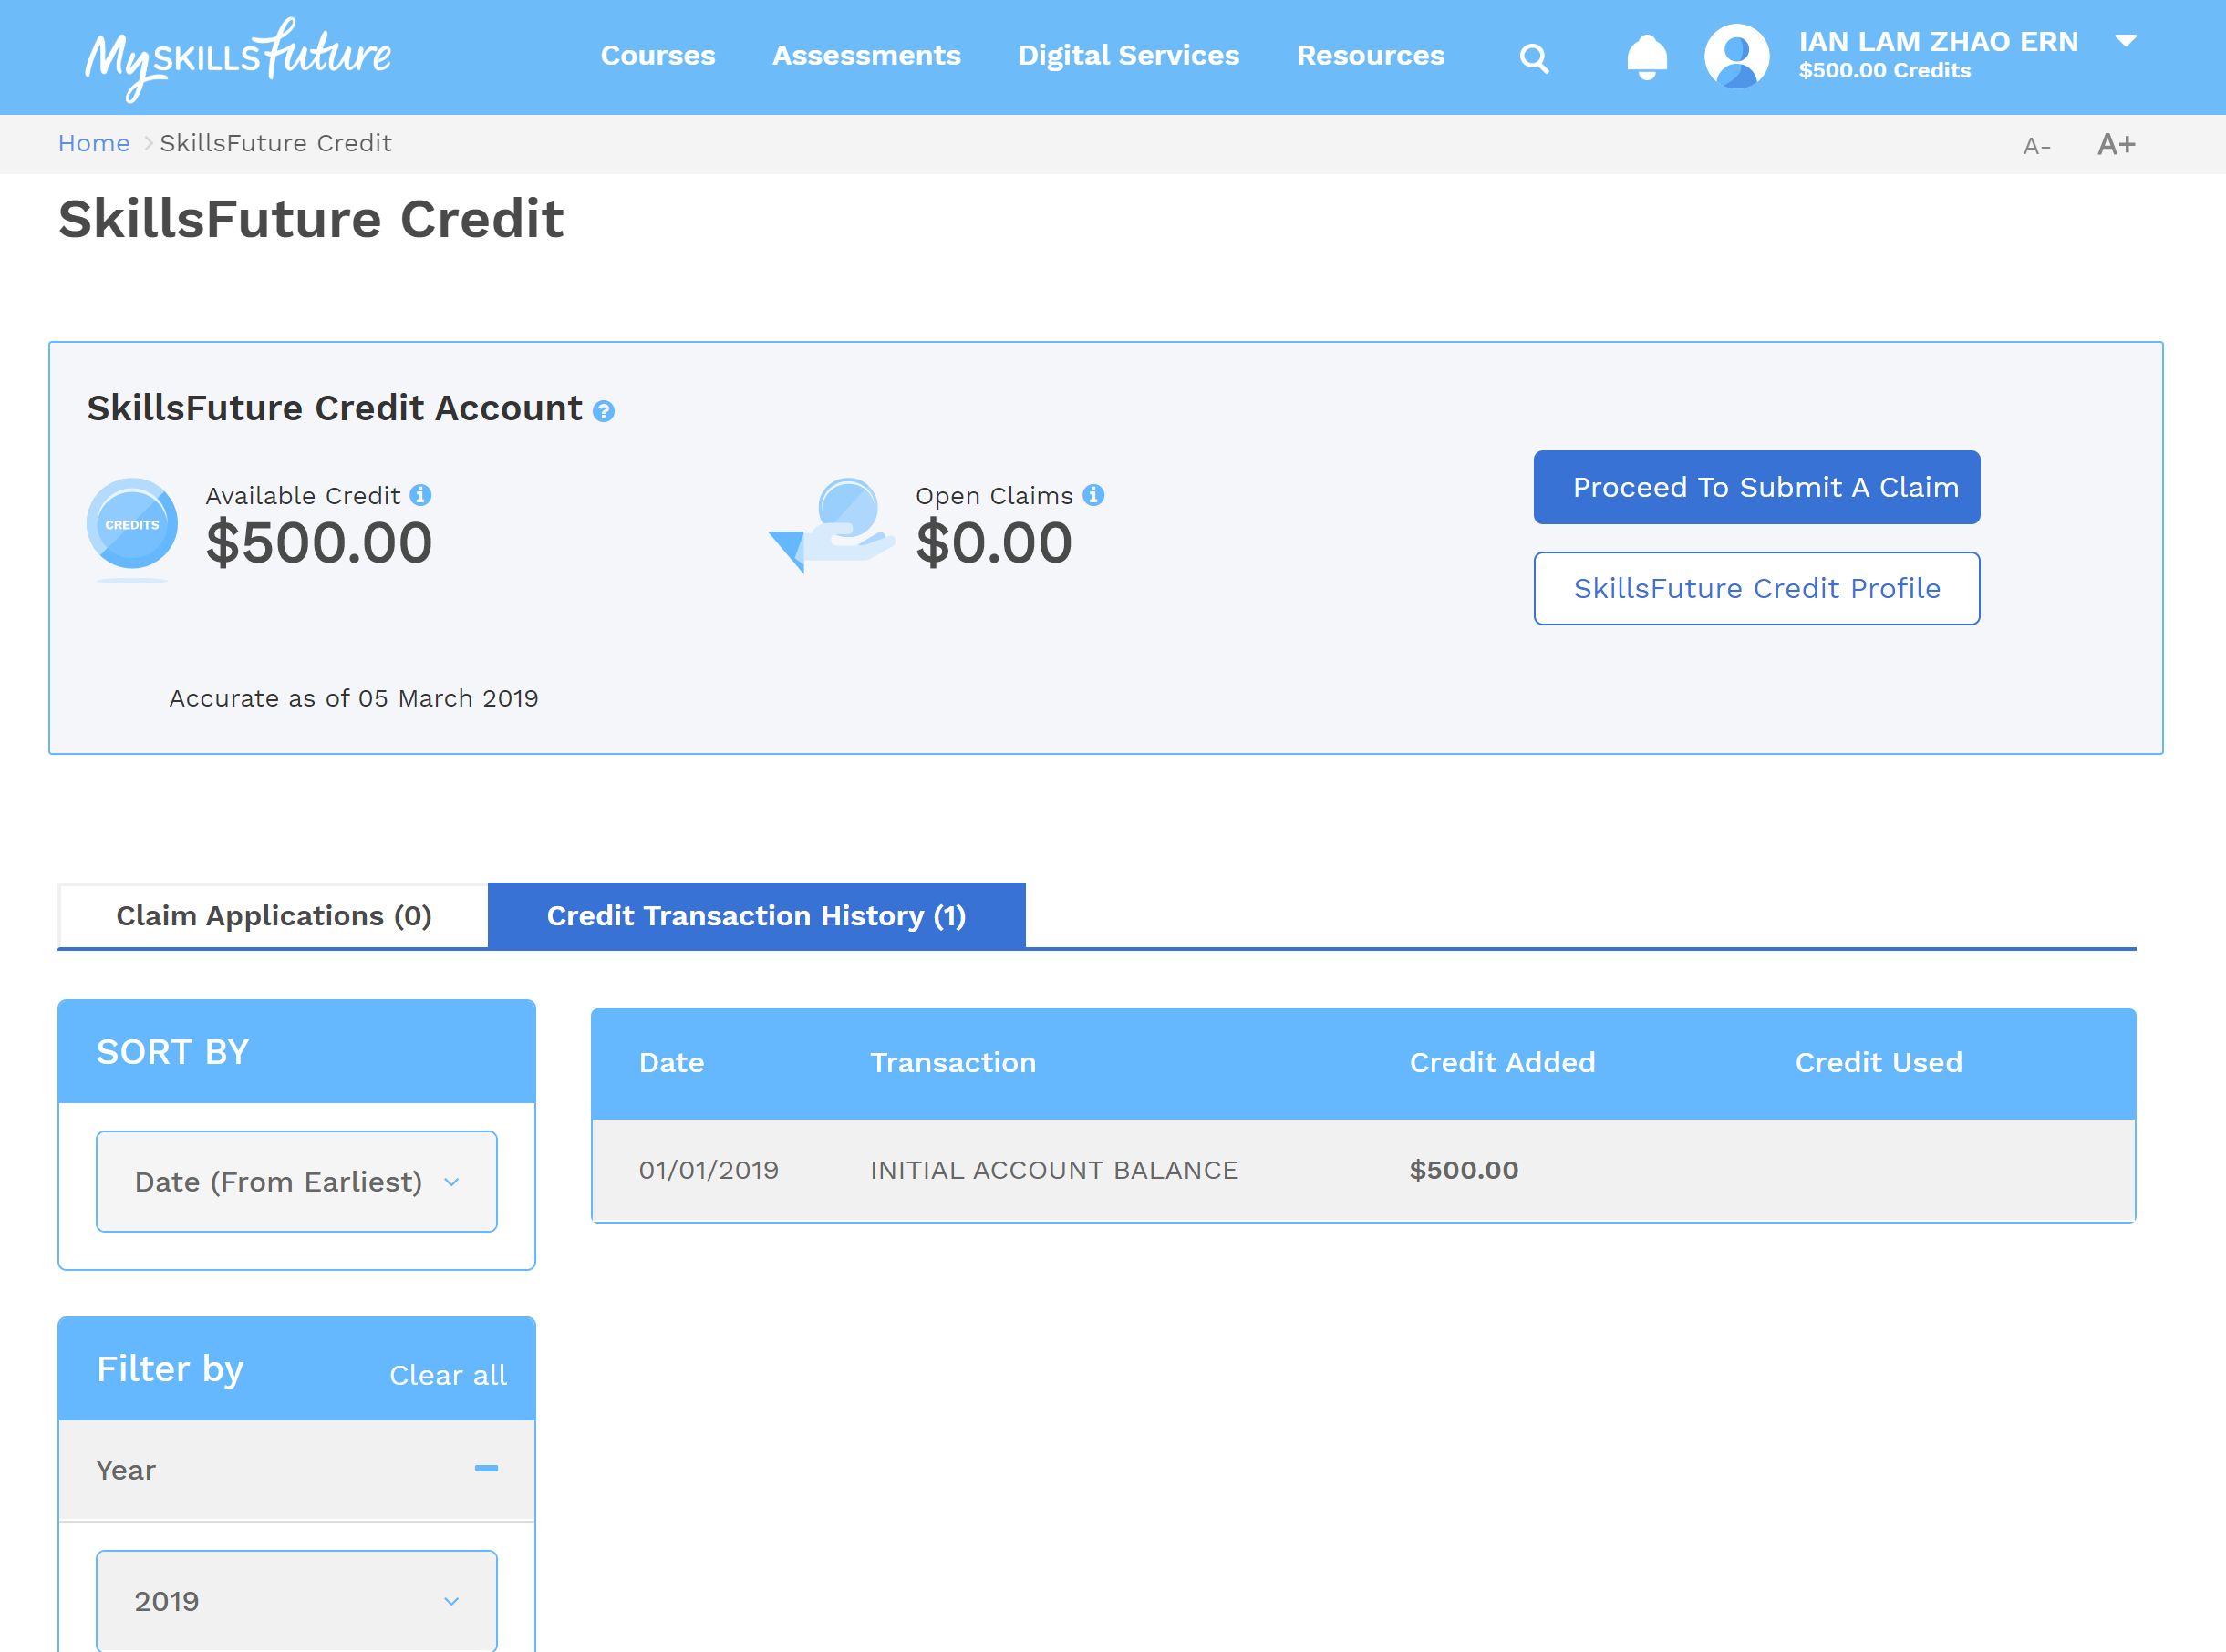
SKILLSFUTURE CLAIM APPLICATION HISTORY STEPS
NAME

Slide 34
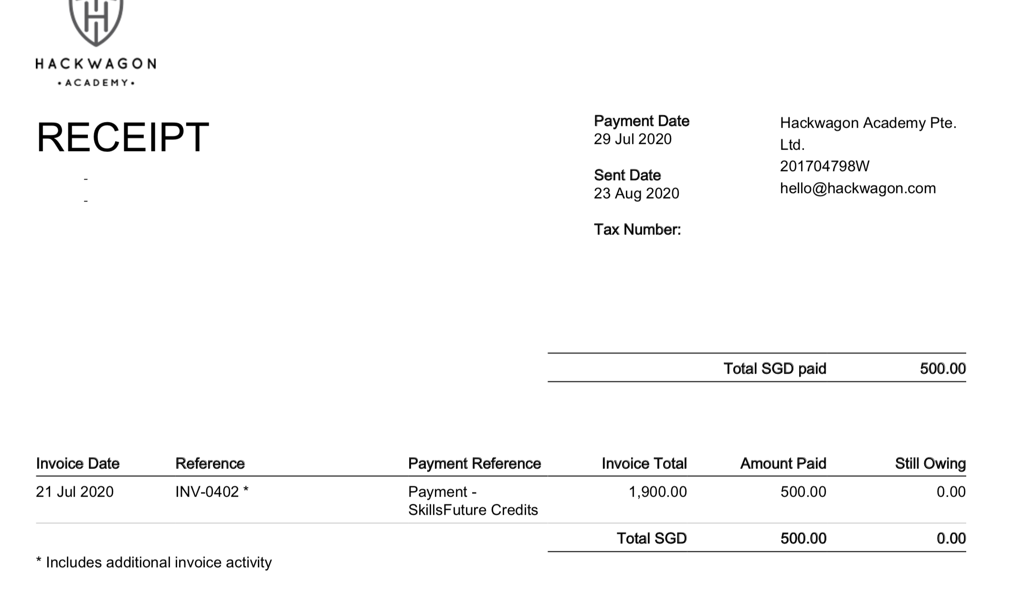
SKILLSFUTURE CLAIM RECEIPT
INV NO.

Slide 35
CLAIM APPLICATION
Frequently Asked Questions
How long does it take to disburse CITREP+ Claim?
Upon complete submission of all the required supporting documents
IMDA will process the application and notify you within 7-10 weeks on the status of approval
After the approval, the GIRO transaction will be made within 3 weeks from the approval notification
If you have any specific questions regarding the ICMS claim:
Email to: citrep@imda.gov.sg

Slide 36


